Slide 1
The Danger of sorcery and the cure
By Umm Ziyad

Slide 2
A
The Satan
The Sorcerer
B

Slide 3
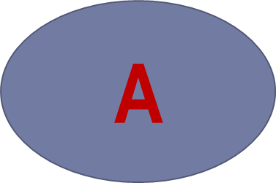
Mother in law
mother
enemy
colleague
1st wife
lover
2nd wife

Slide 4
“One of the people of Paradise will now come to you”
He replied: `My deeds are nothing more than what you saw` Then when I left, he called me back in and said: `My deeds are nothing more than what you saw, but the only thing I do is that I do not hold any grudge against any Muslim or envy anyone for what bounties ALLAH has granted them`; thereupon ‘Abdullaah Ibn ‘Amr R.A said to him: “This difficult quality to obtain is what granted you this rank”. [Ahmad]

Slide 5
“Faith and envy do not go together in the heart of the believer”

Slide 6
Imran Ibn Husayn narrated that the Prophet said:
“He is not one of us who believes in evil omens or talismans, who goes to a fortuneteller, or goes to a sorcerer. Whoever goes to a fortuneteller and believes in what he says has disbelieved in what has been revealed upon” Al Bazzaar

Slide 7
Abu Hurayrah narrated that the Prophet Muhammad said: “
whoever goes to a magician or a fortuneteller and believes in what he tells him disbelieves in what has been revealed to Muhammad.” [Bukhari]

Slide 8
The Prophet also said “whoever goes to a soothsayer or a fortuneteller and consults him, his prayer will not be accepted for forty days.” (Muslim)

Slide 9
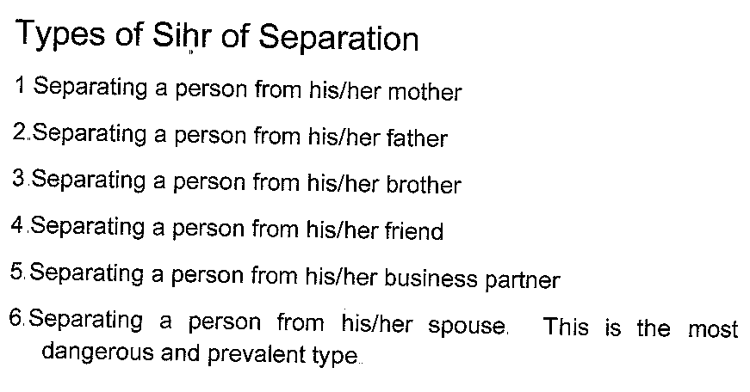
Types of Sihr
الصارم البتار 56
1- Sihr of separation

Slide 10

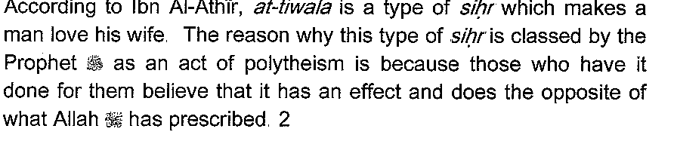
2- Sihr of Love (Tiwalah)

Slide 11
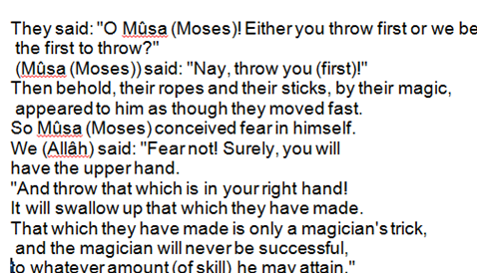
3- Sihr of False appearance of objects
Soorah Taha 65-69

Slide 12
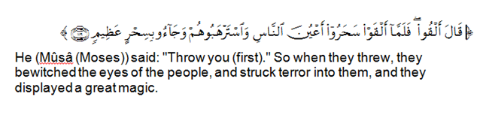

Slide 13
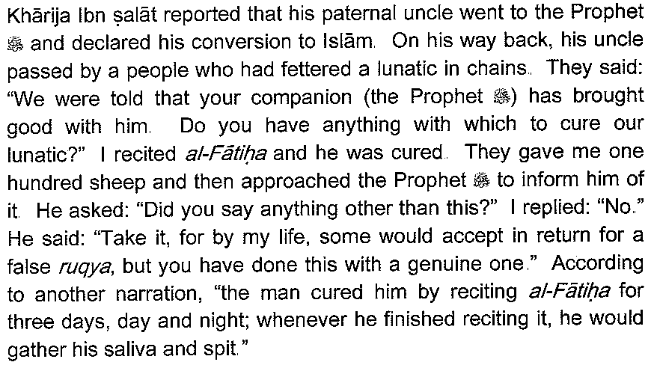
4- Sihr of Lunacy

Slide 14
5- Sihr of lethargy

Slide 15
6- Sihr of hearing voices

Slide 16
7- Sihr of Sickness

Slide 17
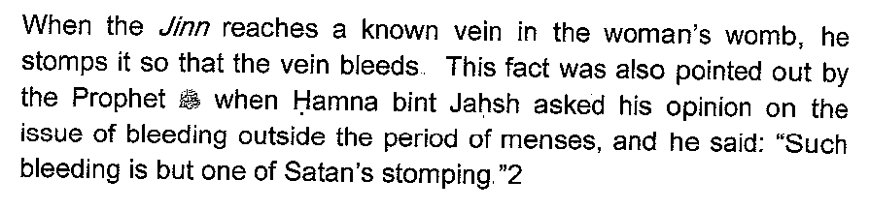
8- Sihr of bleeding

Slide 18
9- Sihr of impending marriage

Slide 19
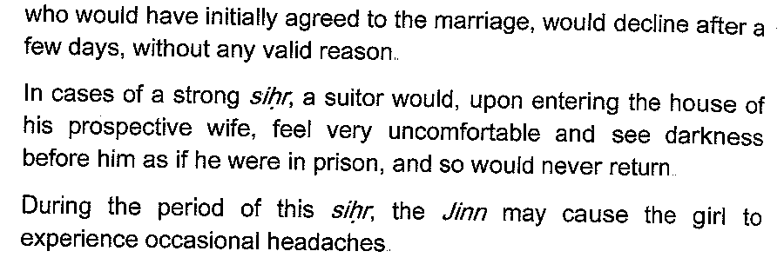

Slide 20
10- Sihr of inability to have intercourse with one’s wife
and
Sihr of inability to have intercourse with one’s husband

Slide 21
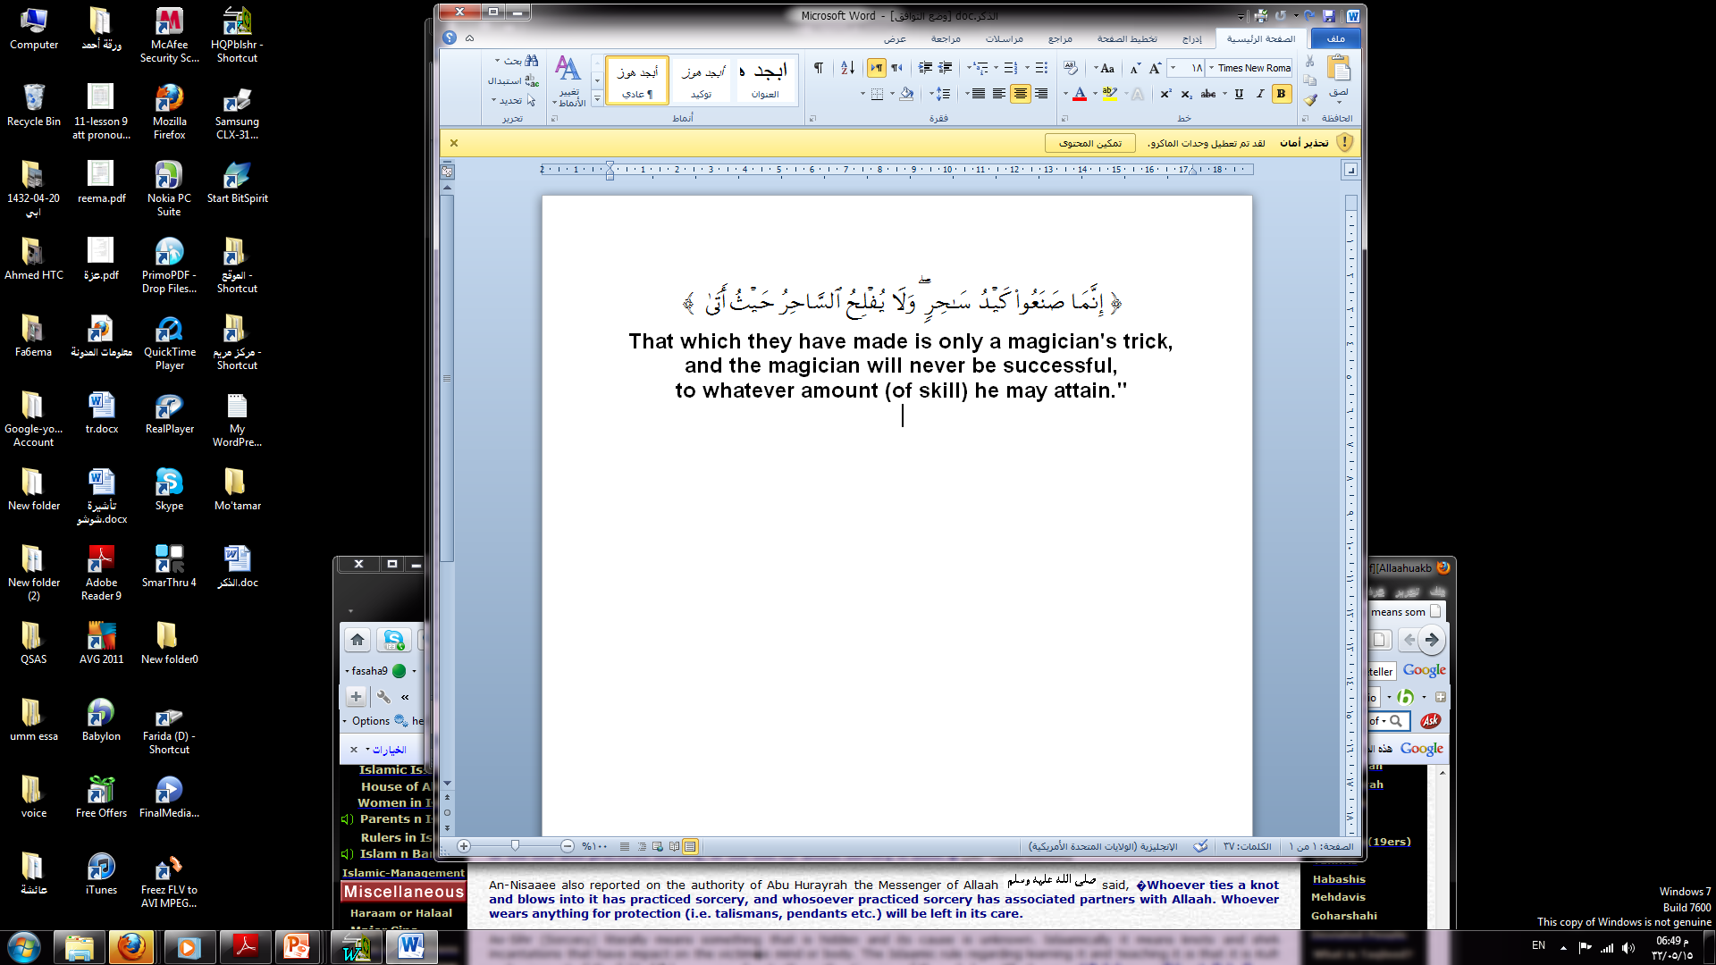
The Sorcerer

Slide 22
How to become a magician
praising, worshipping, seeking refuge, offering scarifies, taking oaths to or in the name of the Chief of Jinns/Shyateen, and tries his best to please him(Chief Jinn).
Arabic video 1,48
http://www.youtube.com/watch?v=wjWX1rg9GYc

Slide 23
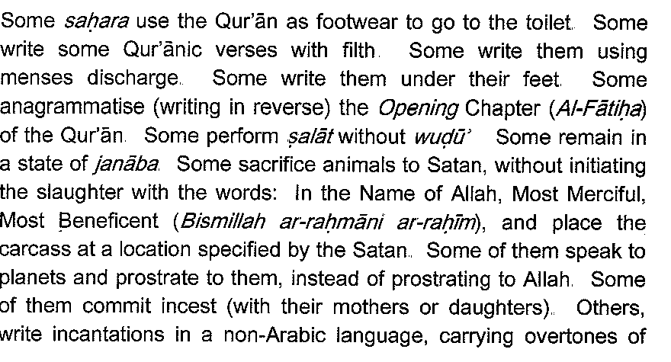
الصارم البتار 37

Slide 24
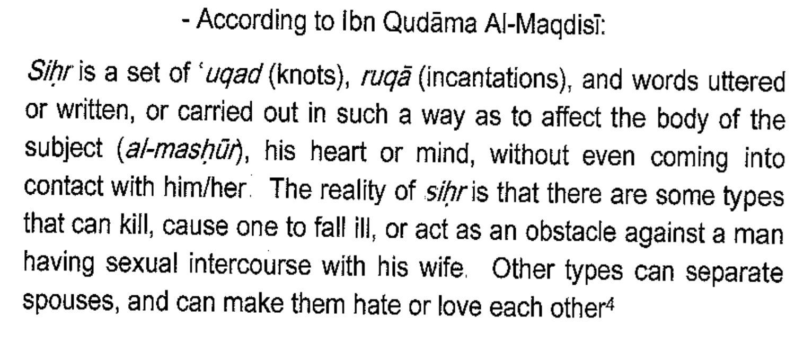
Preparing The Sihr

Slide 25
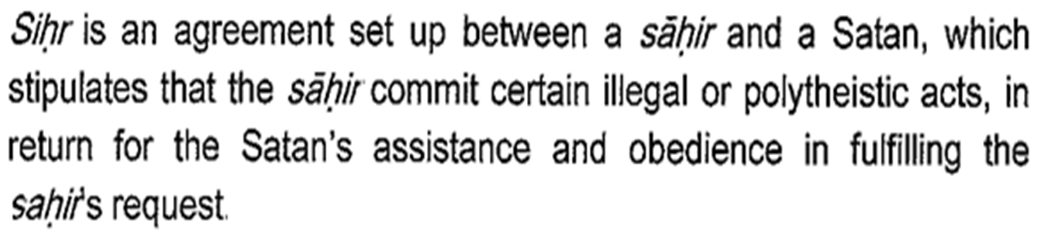

Slide 26
Preparing The Sihr
English video 0.21
http://www.youtube.com/watch?v=Kf6lVgW6RkA

Slide 27
Al-Bukharee and Muslim narrated on the authority of Abu Hurayrah that the Messenger of Allaah said,
“Keep away from the seven destructive sins!” They said, “What are they, O Messenger of Allaah?” He answered, “Associating partners with Allaah; practicing sorcery; taking a life, which Allaah has made forbidden except for a just cause (according to Islaamic Law); eating Riba (usury) eating up an orphan’s wealth; fleeing from the battle field at the time of fighting (with the unbelievers); and accusing chaste women, who never think of anything that can touch their chastity and who are good believers, of fornication.”

Slide 28
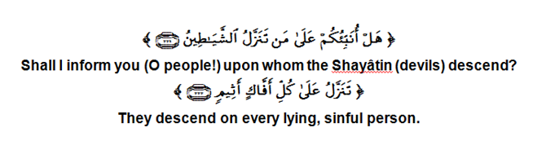

Slide 29
An-Nesaaee also reported on the authority of Abu Hurayrah the Messenger of Allaah saws said,
“Whoever ties a knot and blows into it has practiced sorcery, and whosoever practiced sorcery has associated partners with Allaah. “

Slide 30
The sorcerer is a disbeliever
The Islaamic rule regarding learning it and teaching it is that it is Kufr and going out of the fold of Islaam, according to the authentic view of the scholars.
Allaah says, Sulaimaan did not disbelieve, but the Shayaatin (devils) disbelieved teaching men magic. (Al-Baqarah 2: 102)
He also says in the same verse, And indeed they knew that the buyers of it (magic) would have no share in the hereafter.
He also says, And the magician will never be successful no matter what amount (of skill) he may attain. (Taahaa 20: 69)

Slide 31
The sorcerers should be killed even if they repent
Executing sorcerers is therefore the correct opinion of the scholars, even if he shows repentance because the companions did not ask the sorcerers to repent before they killed them. Further, most sorcerers are liars. If a sorcerer is given a chance to repent, he is unlikely to be truthful. If he is however truthful in his heart his repentance will benefit him before Allaah but that does not save him from being executed because he has practiced a malicious and wicked act.

Slide 32
“They followed what the Shayaateen (devils) gave out (falsely of the magic) in the lifetime of Sulayman. Sulayman did not disbelieve, but the Shayaateen (devils) disbelieved, teaching men magic and such things that came down at Babylon to the two angels, Harut and Marut, but neither of these two (angels) taught anyone (such things) till they had said, "We are only for trial, so disbelieve not (by learning this magic from us)." And from these (angels) people learn that by which they cause separation between man and his wife, but they could not thus harm anyone except by Allah's permission. And they learn that which harms them and profits them not. And indeed they knew that the buyers of it (magic) would have no share in the Hereafter. And how bad indeed was that for which they sold their ownselves, if they but knew.” (Al-Baqarah 2:101-102)

Slide 33
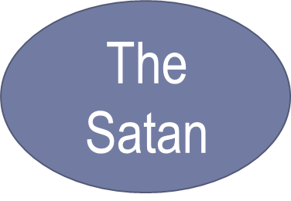
Satan الشَّيْطان ,in the Arabic language, is a general term for any arrogant rebel. It is used, in general, for that one specific being because he was so arrogant and rebelled against his Lord.
He is from the Jinn
«إِلا إبْلِيسَ كانَ مِنَ الْجِنِّ»
.Except Iblees and he was of the jinn

Slide 34
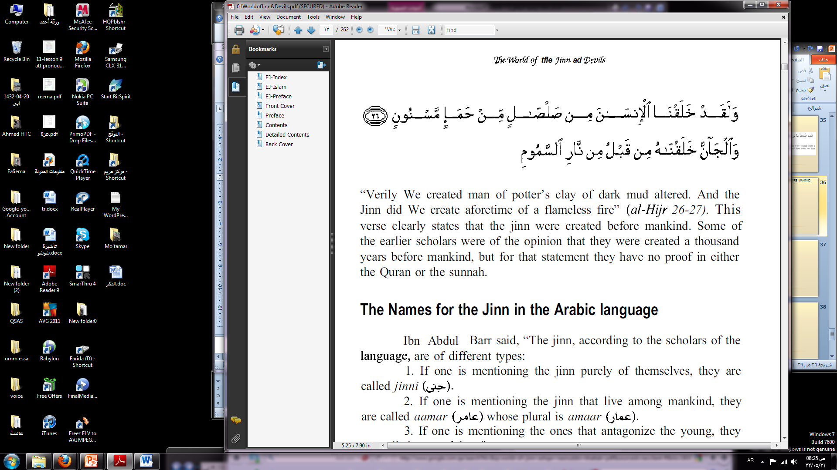
the jinn were created before mankind.

Slide 35
Iblees and Adam
When Allah breathed into Adam his spirit, he ordered the angels to prostrate to Adam. Iblees used to worship Allah with the angels so the order was also addressed to him. But Iblees considered himself too great and, out of pride, he refused to prostrate to Adam. He cried, .I am better than him.. You created me from fire and you created him from clay...

Slide 36
The revenge
Satan was cast out of paradise due to his pride but he took a promise from Allah to be left alive until the day of judgment .
He said: Reprieve me till the day when they are raised (from the dead). He said: Lo! You are of those who are reprieved.
Then the accursed one made a promise and vow to himself that he would mislead the offspring of Adam and plot against them. .He said: Now, because you have sent me astray, verily I shall lurk inambush for them on your Right Path. Then I shall come upon them from before them and from behind them and from their right and theirleft, and you will not find most of them beholden (to You). 70

Slide 37
.

